Slide 1
Visitor Design Pattern
The visitor pattern allows defining new operations to the collection of objects without changing the structure of the objects themselves.
This allows us to separate the class from the logic it implements.
The Visitor pattern is less important in JavaScript as it offers the ability to add and remove methods at runtime but it is still useful to have that pattern in mind.

Slide 2
Visitor Design Pattern
The extra operations can be encapsulated in a Visitor object.
The objects can have a visit method that accepts the Visitor object.
The Visitor can then make the required changes and perform the operations on the object that received it.
This allows the developers to make future extensions, extend the libraries/frameworks, etc.

Slide 3
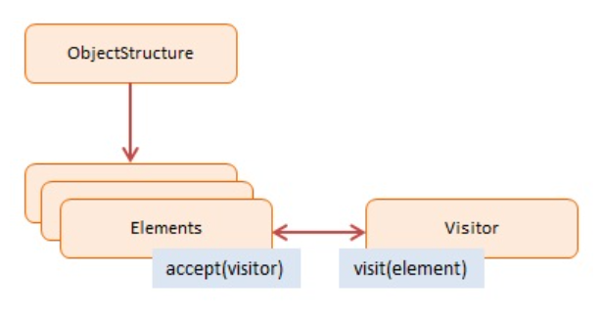
Diagram
ObjectStructure:
maintains a collection of Elements which can be iterated over
Elements:
defines an accept method that accepts visitor objects
in the accept method the visitor's visit method is invoked with 'this' as a parameter
Visitor:
implements a visit method. The argument is the Element being visited. This is where the Element's changes are made

Slide 4
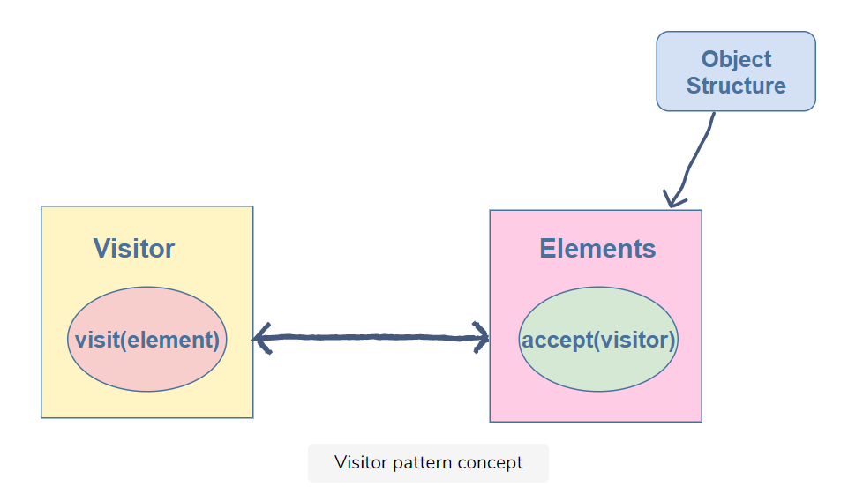
Visitor Pattern Concept

Slide 5
Example
In the example blow, we have a book shop. The Book class is used to represent a book in the shop.
The getPrice method returns the price, getName returns the name, and getID returns the id of the book.
Now the book shop introduces a discount on the books that cost more than 50 dollars. Hence, now we want to perform an additional operation of visiting the books and implementing the discount on them. Here, we use the visitor pattern. We introduce a Visitor that will visit the books and update their prices. However, the book objects should have some function that allows the visitor to visit them and perform the operation. For this purpose, we have defined the accept method in our Book class.

Slide 6
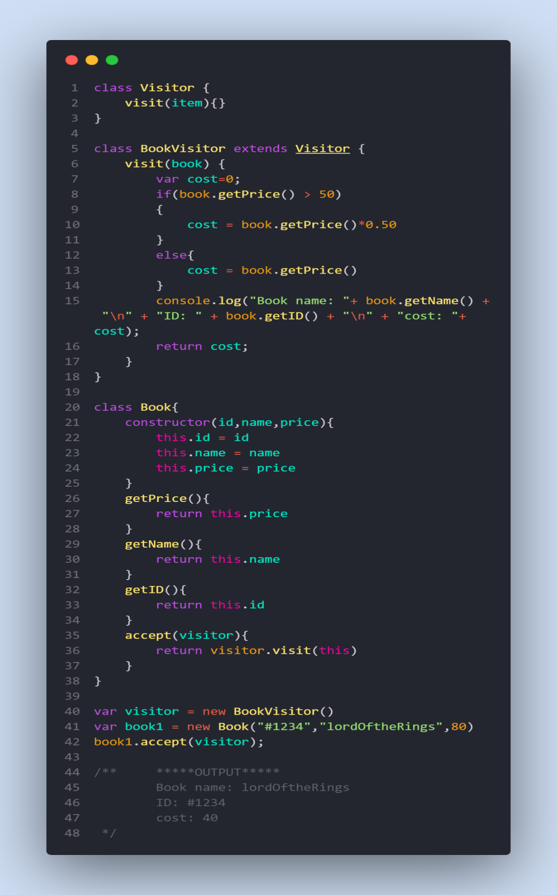
Continued...
Accept takes a visitor object as an argument and allows it to visit the current book (this is pointing to the current book) by calling its visit function.
Visitor has a visit function that takes the item it wants to visit as a parameter.
The visit function checks the price of the book it is visiting. If it is greater than 50, it applies a fifty percent discount to it, else, it keeps the price as it is.

Slide 7
When to use
Similar operations need to be performed on different objects of a data structure.
Specific operations need to be performed on different objects in the data structure.
You want to add extensibility to libraries or frameworks.

Slide 8
Useful Resources
https://www.educative.io/collection/page/5429798910296064/5725579815944192/4888444644884480
https://www.dofactory.com/javascript/design-patterns/visitor
https://dev.to/francescoxx/visitor-pattern-5fbi
https://en.wikipedia.org/wiki/Visitor_pattern

